Slide 1
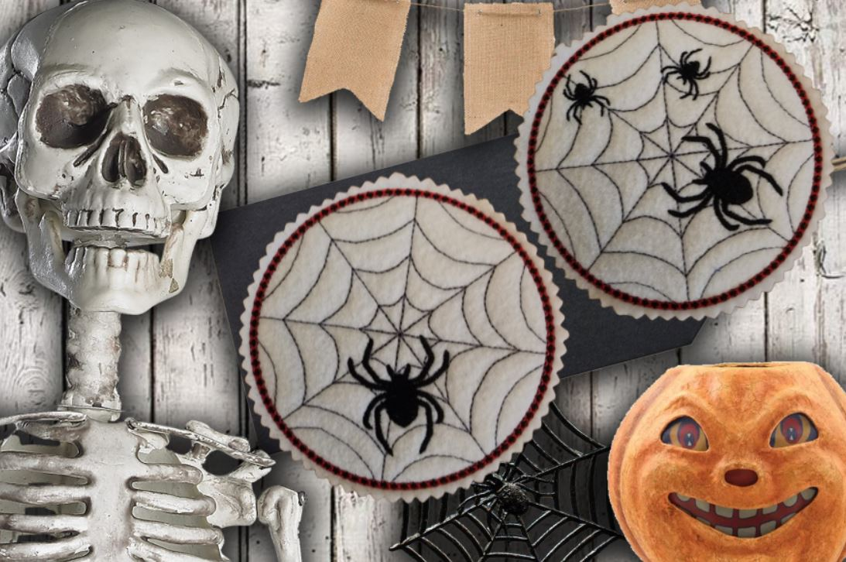
Kellie’s Designs - Spider Napkin Holder Cover Tutorial.

Slide 2
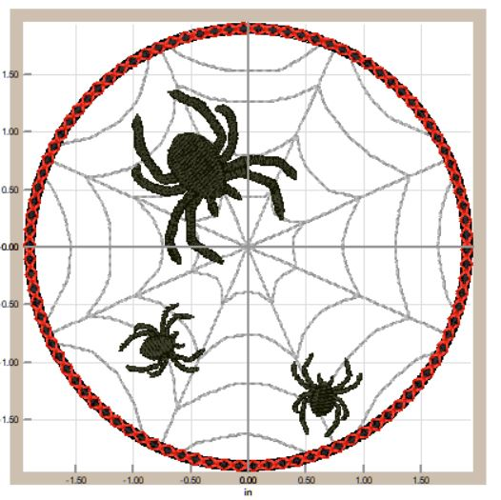
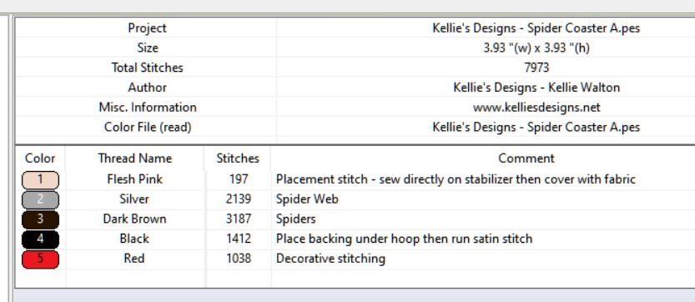

Slide 3
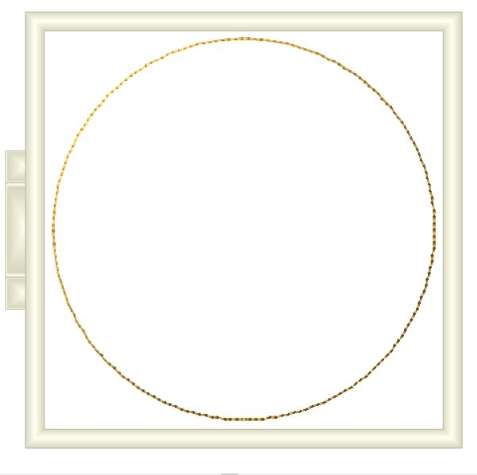
Step 1: Hoop cutaway stabilizer and stitch color change #1 directly onto the stabilizer. This is your placement stitch. Cover stitch line with your choice of fabric, felt or vinyl.
Fabric placement line – stitch on stabilizer.

Slide 4
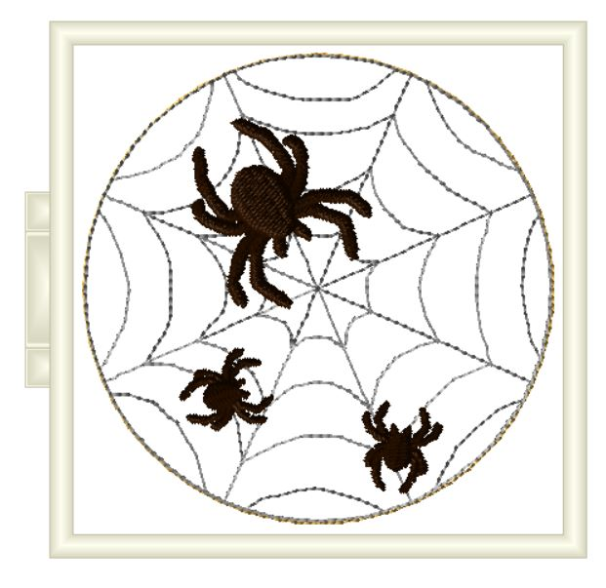
Step 2: Stitch color changes 2 – 3. These are your design details.

Slide 5
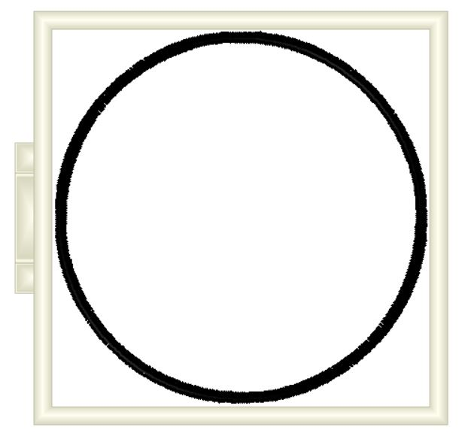
Step 3: After color change 3, place your backing fabric UNDER your hoop and run color change 4 (satin border) to secure the front to the back.

Slide 6
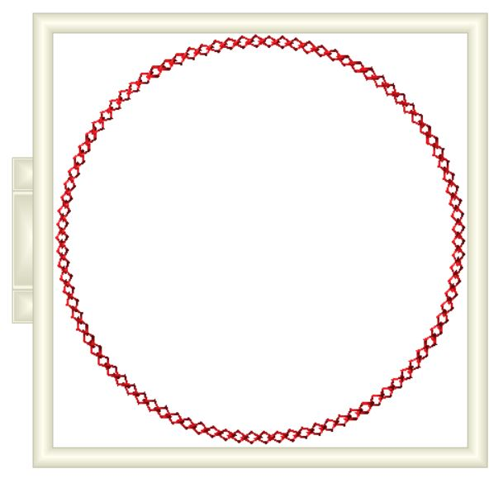
Step 4: Color change 5 is the optional decorative stitching that goes over the satin stitching.

Slide 7
Step 5: Remove hoop from machine, carefully unhoop and cut around your coasters.
*I typically make my coasters with felt. I like the look – however you can use vinyl, cork or fabric.

Slide 8
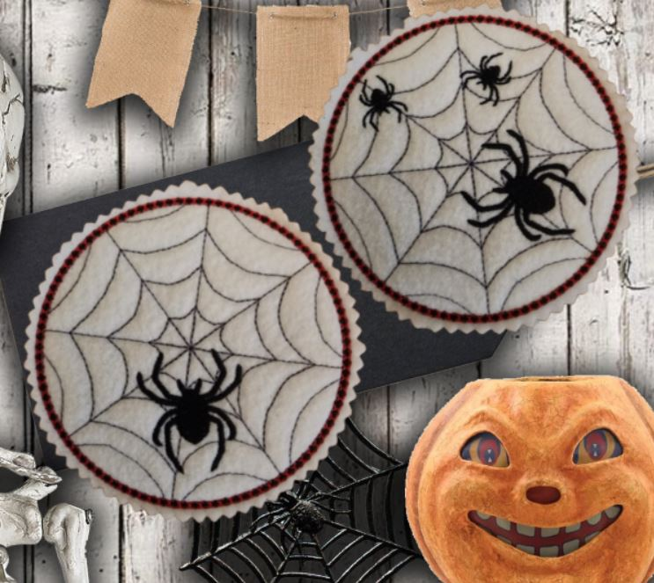

Slide 9
Coaster B is EXACTLY the same steps as Coaster A … placement line goes on the stabilizer, cover with fabric – stitch your design, then before the satin stitch … place your backing UNDER the hoop and run the final color change and decorative stitching.

Slide 10
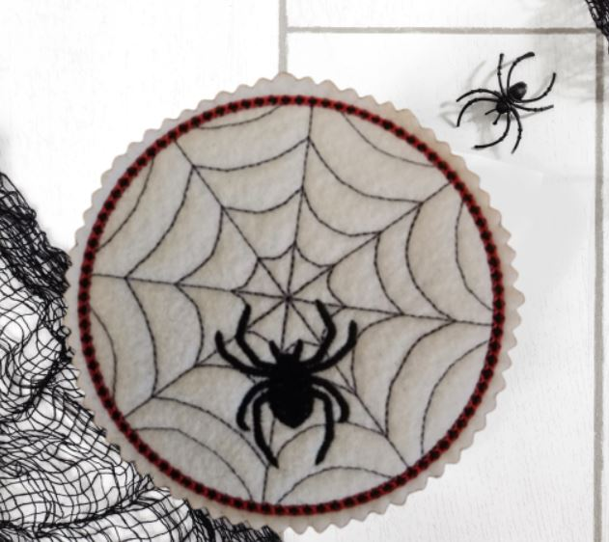

Slide 11
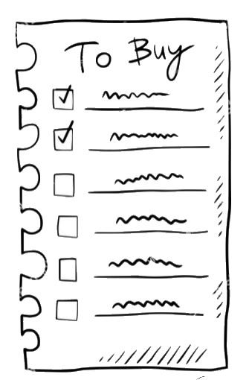
Links to supplies I used
The following are links to some of the products that I have used when making this project: Cut away stabilizer Embroidery thread
Kai serrated scissors Fiskars pinking shears

Slide 12
Thank you!!
I hope you enjoyed making your coasters! If you have any questions or encounter problems – PLEASE don’t hesitate to ask. Also – our Facebook group is a great source of information and inspiration. Please feel free to share your completed project photos with us!! Copyright 2023 - Kellie's Designs Disclaimer: I am an Amazon affiliate - which means that I may receive a small commission based on qualified orders placed through links I share. This in no way impacts your pricing and I only recommend items that I personally have purchased and used.

